Slide 1
Workspace
Munish Arora
Workspace
Design a Report
Enhance a Report

Slide 2
Power BI Workspace
Managing Workspaces
Lineages
Creating And Managing Apps
Managing Sensitivity

Slide 3

Lesson 1: Introduction

Slide 4
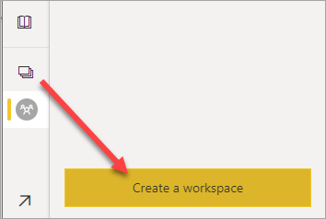
Introduction
A centralized repository to:
Collaborate with colleagues and teams.
Create collections of reports and dashboards.
Workspaces provide the following benefits:
Share and present reports in a single environment.
Enable the highest level of security.
An environment for housing reports and dashboards for use by others.

Slide 5
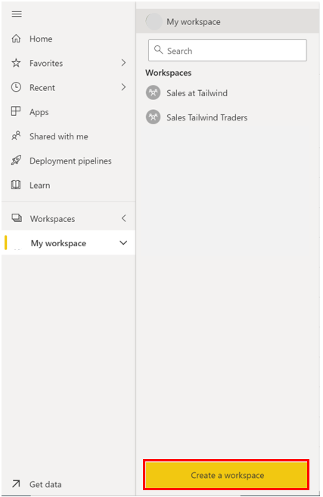
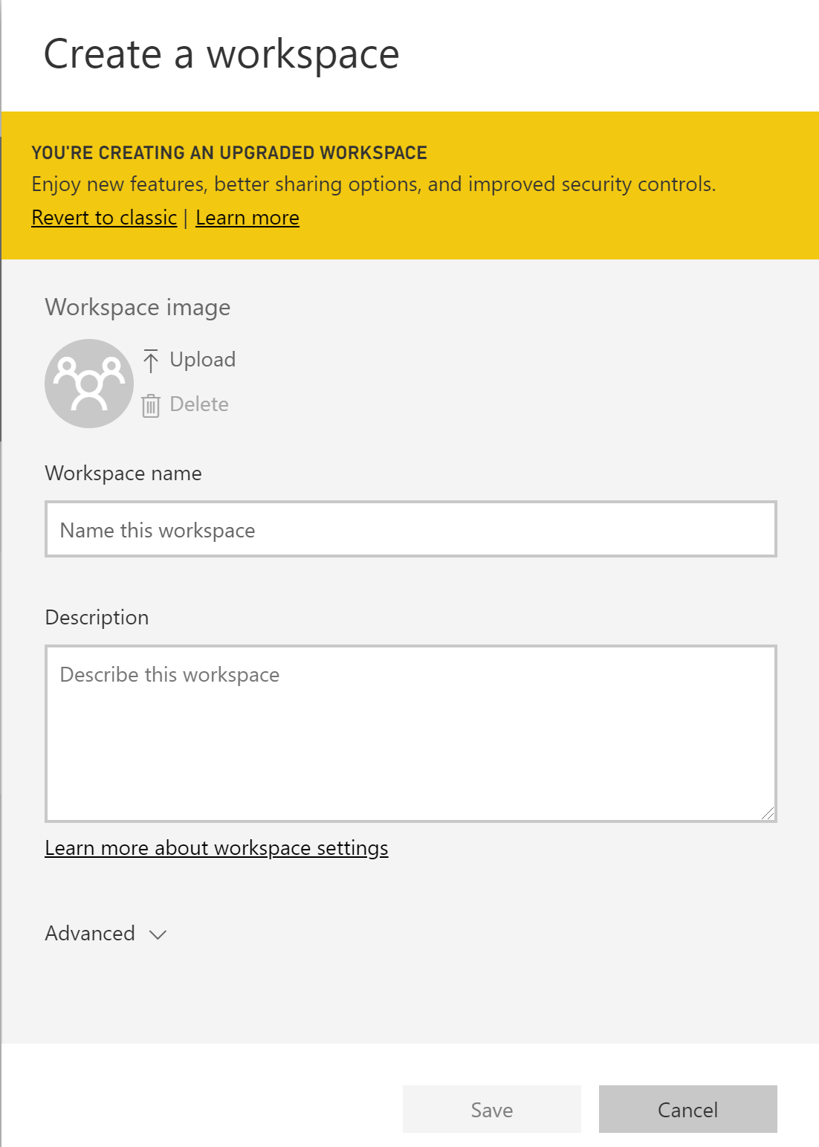
Create a Workspace
Make reports easily viewable and sharable.
Workspace Created

Slide 6
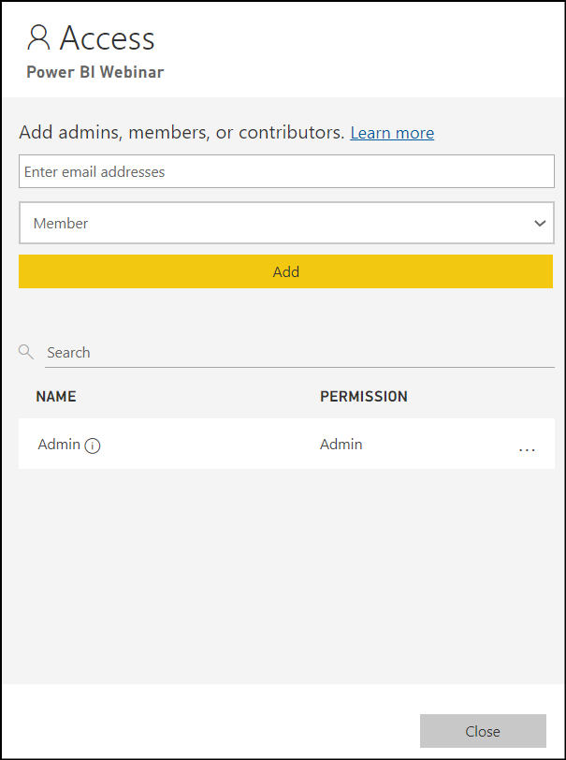
Assign Workspace Roles
Roles determine what a user can do in a workspace, so that teams may collaborate.
Key roles include:
Admin.
Member.
Contributor.
Viewer

Slide 7
Workspace Roles
All admin tasks EXCEPT remove users
Cannot delete workspaces
Cannot update the metadata about the workspace
Can only view a report or dashboard
Can read data stored in dataflows
Cannot add/remove users
Admin
Member
Contributor
Viewer
Add/remove users
Publish, update, share and app in a workspace
Create, edit, delete, publish reports and content
View and interact with reports and dashboards
Configure data refreshes
Can create, update, publish content and reports
Can schedule data refreshes
Cannot add/remove users
Cannot publish, update, edit an app unless given ability by admin

Slide 8
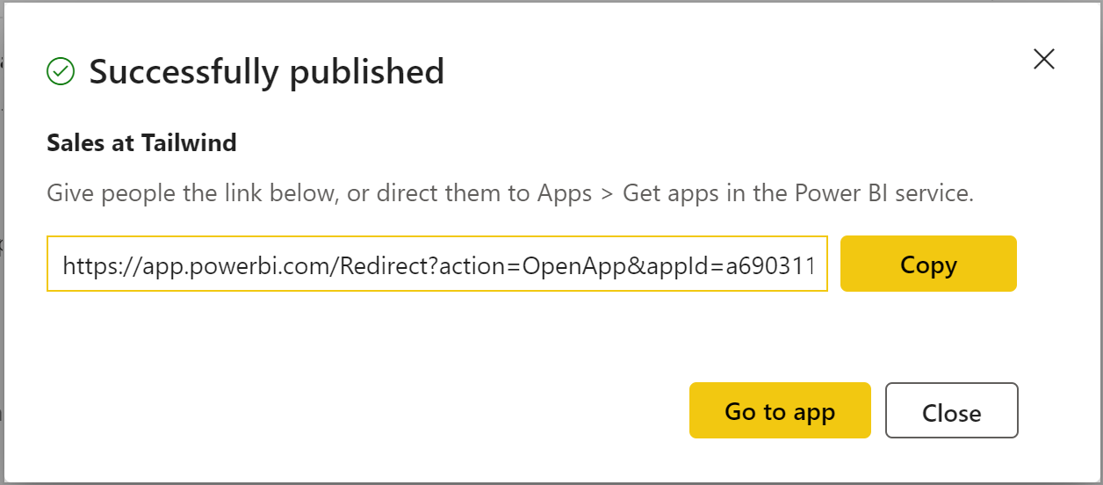

Create Apps
An app is a Power BI content type that combines related dashboards and reports
These apps are then shared with consumers

Slide 9

Configure and Update a Workspace App
How do you update a published App?
Navigate back to the workspace.
Make any necessary updates.
Click Update App (previously called Publish App).

Slide 10
Knowledge Check
Q01 – How is the admin workspace different from other types of workspace roles?
Admins are the only role that can remove users and delete workspaces.
Admins are the only role that can publish, update, share and app in a workspace
Admins are the only role that can schedule data refreshes
A01 - A

Slide 11
Knowledge Check
Q02 –What is the best description of a workspace?
A centralized location or repository in Power BI Desktop that allows you to collaborate with colleagues and teams to create collections of reports, dashboards, etc.
A centralized location or repository in Power BI Service that allows you to collaborate with colleagues and teams to create collections of reports, dashboards, etc.
A centralized location or repository in Power BI Data flows that allows you to collaborate with colleagues and teams to create collections of reports, dashboards, etc.
A02 – B

Slide 12
Lesson 2: Sharing And Managing Assets

Slide 13
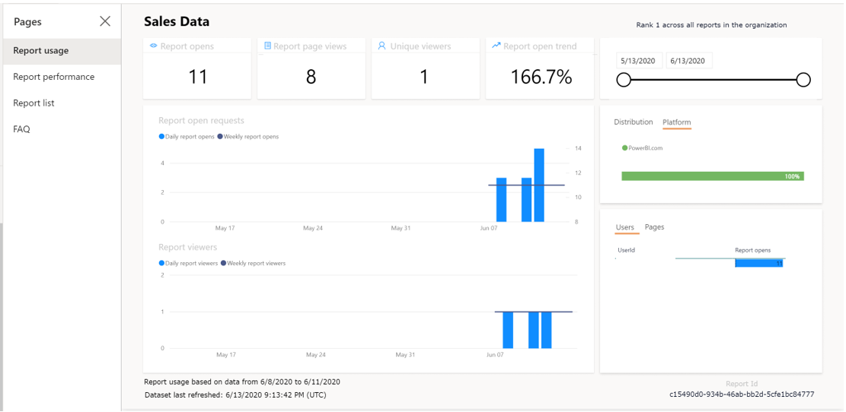
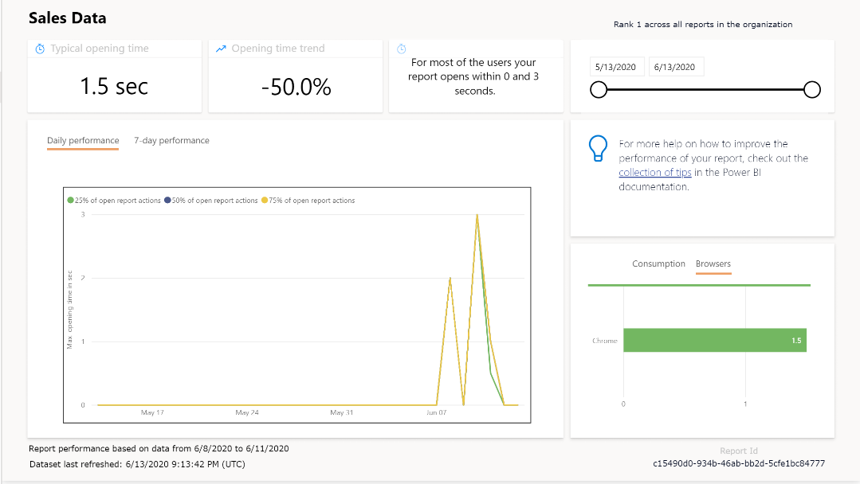
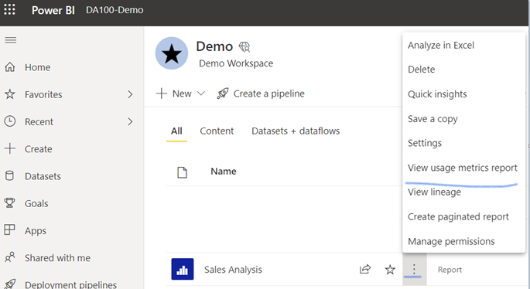
Monitor Usage and Performance

Slide 14
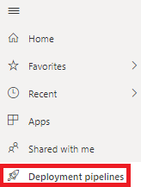
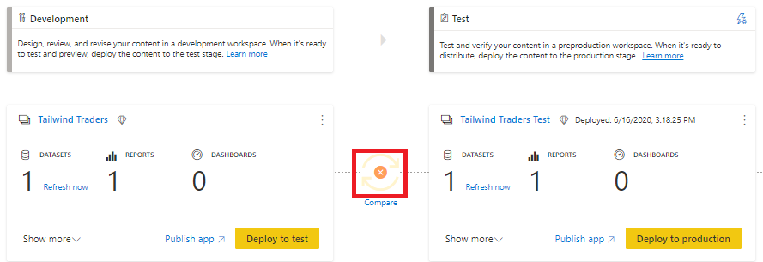
Development Lifecycle Strategy
You have to be a member of Power BI Pro to be able to create Deployment Pipeline
License Type required to access Workspace should be ‘Premium per user’
Manage content in dashboards, reports, and datasets in different environments.

Slide 15
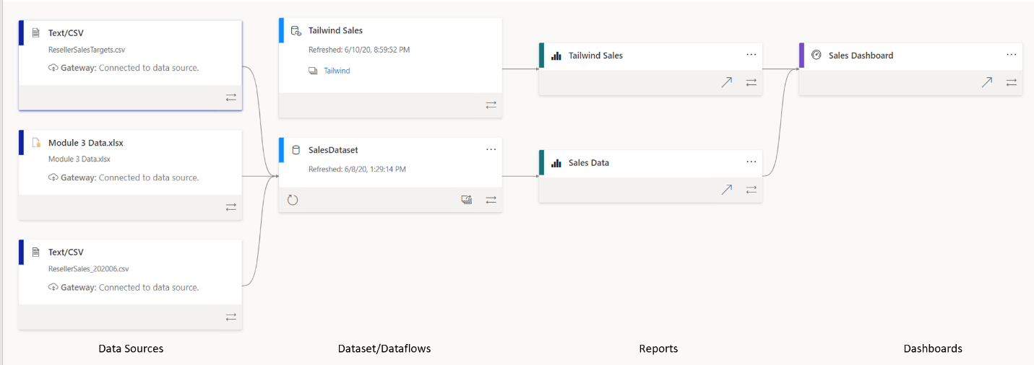
Viewing Data Lineage
Lineage view is a feature within the Power BI Service which gives a single relational view of all the data and visual building blocks of the Power BI workspace

Slide 16
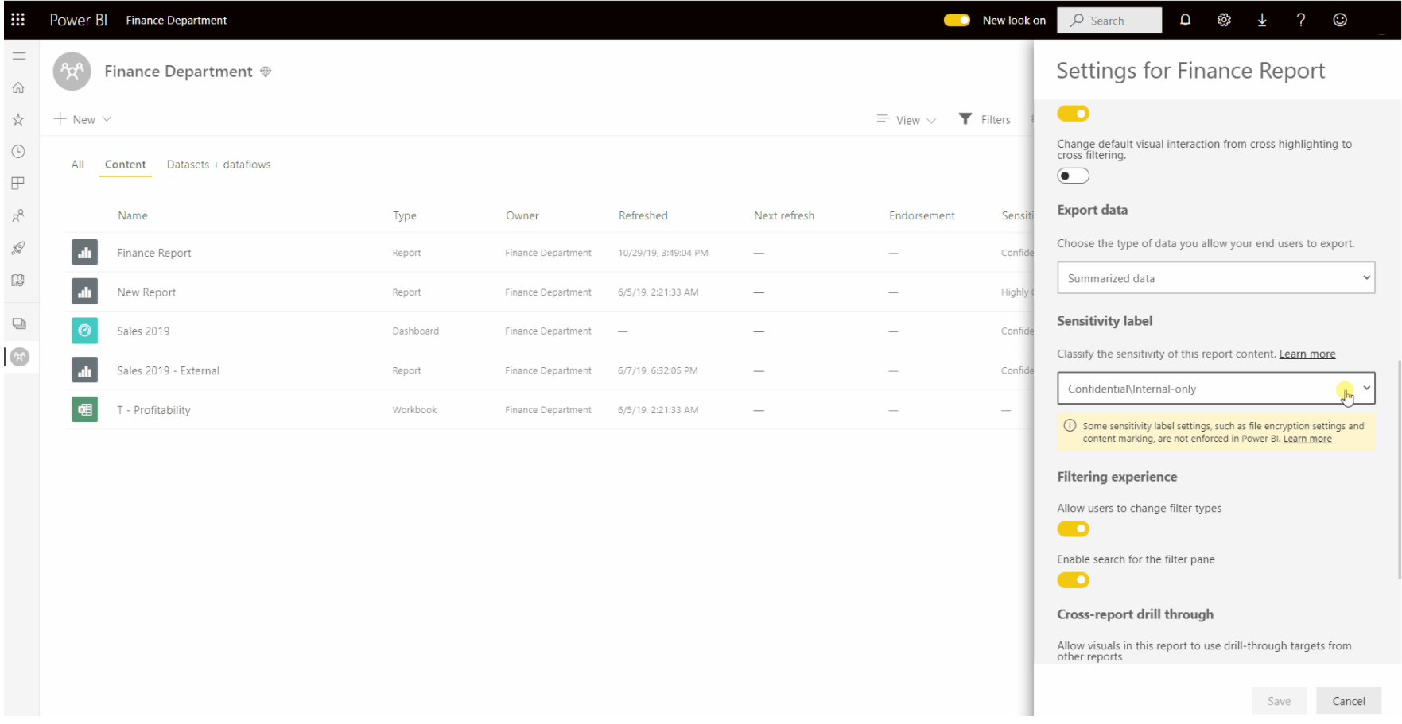
Data Protection
Classify and label sensitive Power BI data
Enforce governance policies even when Power BI content is exported
Monitor and protect user activity on sensitive data in real time
Empower security administrators

Slide 17
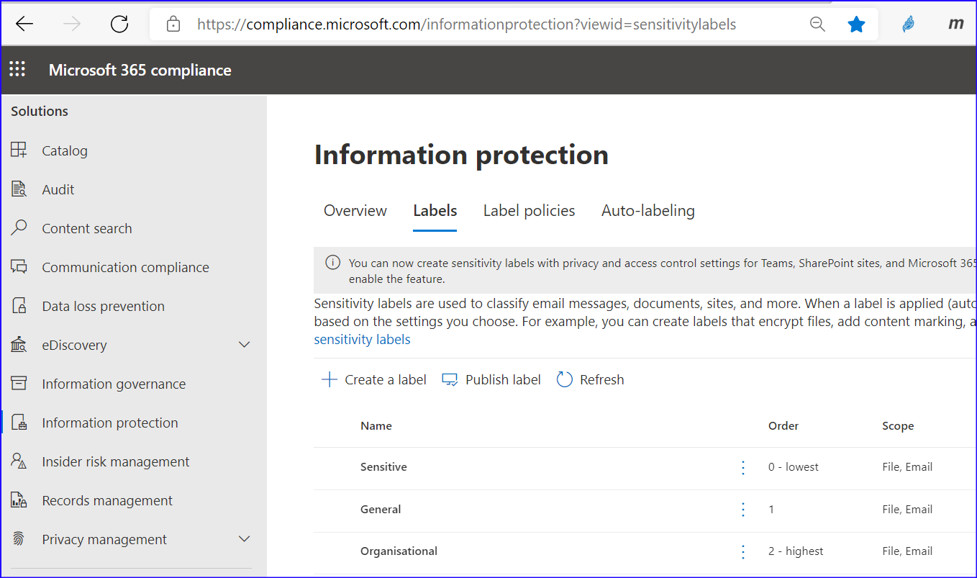
Data Protection
For creating sensitivity labels
Go to https://compliance.microsoft.com
Click on Information Protection
Click on Labels
Create and publish each label
For details please refer to Create and publish sensitivity labels - Microsoft 365 Compliance | Microsoft Docs

Slide 18
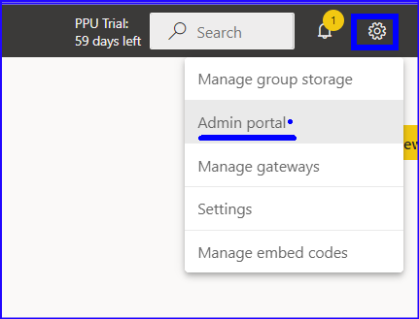
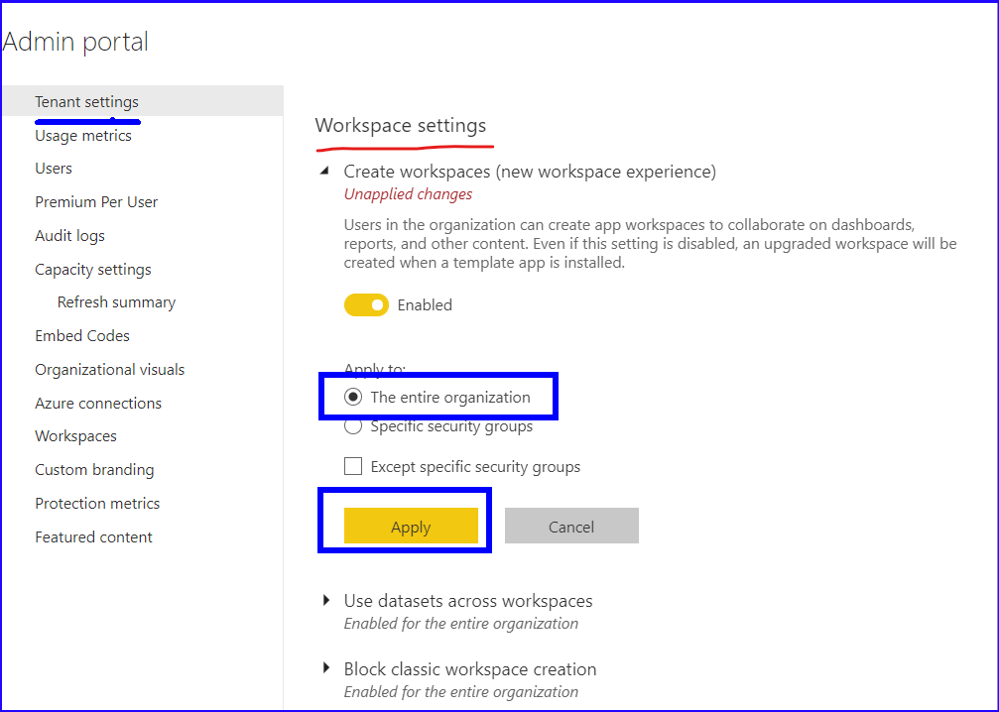
Data Protection
Enable Sensitivity labels in Power BI by going to Settings| Admin Portal
It will take some time after these labels are reflected in Power BI.

Slide 19
Knowledge Check
Q01 – What feature in Power BI service can you use to troubleshoot the flow of data from its source to destination?
View Lineage
Report Lineage
Dashboard Lineage
A01 - A
Q02 – A key tenet of data protection is sensitivity labels. What does it specify?
Which data can be exported.
Which data can be viewed
Which data can be refreshed
A01 - A

